Slide 1
Virtualization

Slide 2
Virtualization
What is virtualization?
Virtualization is the ability to run multiple operating systems on a single physical system and share the underlying hardware resources.
It is the process by which one computer hosts the appearance of many computers.
Virtualization is used to improve IT throughput and costs by using physical resources as a pool from which virtual resources can be allocated.
Different Computing Models
Traditional App/Server
Virtual Server model
Massively virtualized model (Cloud)
Why Virtualization makes sense?
Notes:
Virtualization broadly describes the separation of a
resource or request for a service from the underlying physical
delivery of that service.
in other words ...
Use a computer's processing power in any number of ways to support your business needs.

Slide 3
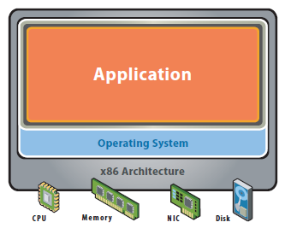
Traditional App/Server
Notes:
Single OS image per machine
Software and hardware tightly coupled
Running multiple applications on same machine
Underutilized resources
Inflexible and costly infrastructure

Slide 4
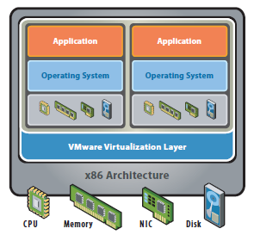
Virtual Server Model
Notes:
Hardware-independence of operating system and applications
Virtual machines can be provisioned to any system
Can manage OS and application as a single unit by encapsulating them into virtual machines

Slide 5
Virtualization - Green Focus
The Reality:
Most servers only use 5-15% of their capabilities on average, while consuming 60-90% of their peak power.
The Solution - Virtualization:
Use one server to host multiple applications.
Reduce energy consumption
Reduce CO2 emissions
Running fewer, highly utilized servers frees up space and power. Less space and power is better for environment and saves money.
Notes:
Tie this back to the traditional model and use as basis for virtual model.
When you have "this" - these are the trouble areas. In order to resolve these trouble areas, move to a virtual model.
Every server virtualized saves 7000kWh of electricity annually, or about $700 in energy costs.
4 tons of CO2 are eliminated for every server virtualized, the equivalent to taking 1.5 cars off the h

Slide 6
Virtualization - Why Virtualize?
Reduce Real Estate Needs
Increase Up Time
Reduce CO2 Emmissions, Power and Cooling Requirements
Increase Flexibility
Reduce Overall Costs
Notes:
More out of less Pool common infrastructure resources and break the legacy “one application to one server” model with server consolidation.

Slide 7
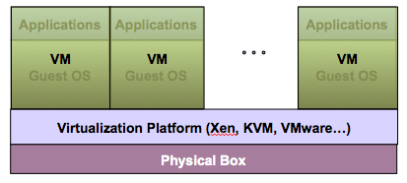
Virtualization Architecture
A Virtual machine (VM) is an isolated runtime environment (guest OS and applications)
Multiple virtual systems (VMs) can run on a single physical system

Slide 8
Hypervisor
A hypervisor, a virtual machine manager/monitor (VMM), or virtualization manager, is a program that allows multiple operating systems to share a single hardware host.
Each guest operating system appears to have the host's processor, memory, and other resources all to itself. However, the hypervisor is actually controlling the host processor and resources, allocating what is needed to each operating system in turn and making sure that the guest operating systems (called virtual machines) cannot disrupt each other.

Slide 9
Benefits of Virtualization
Maximizing Resources: Utilize maximum amount of required resources
Reducing Hardware Cost: Sharing of resources helps cost reduction
Isolation: Virtual machines are isolated from each other as if they are physically separated. Security
Enjoying benefits of OS Services: Virtual machines encapsulate a complete computing environment with multiple OSs
Using Multiple Systems: Virtual machines run independently of underlying hardware
Portability: Virtual machines can be migrated between different hosts.
Testing Beta Software & maintaining legacy application

Slide 10
Virtualization in Cloud Computing
Cloud computing takes virtualization one step further:
You don’t need to own the hardware
Resources are rented as needed from a cloud
Various providers allow creating virtual servers:
Choose the OS and software each instance will have
The chosen OS will run on a large server farm
Can instantiate more virtual servers or shut down existing ones within minutes
You get billed only for what you used

Slide 11
Implementation levels of Virtualization
Virtualization at ISA Level
Virtualization at HAL Level
Virtualization at OS Level
Virtualization at Application Level
Virtualization at User/Library Level

Slide 12
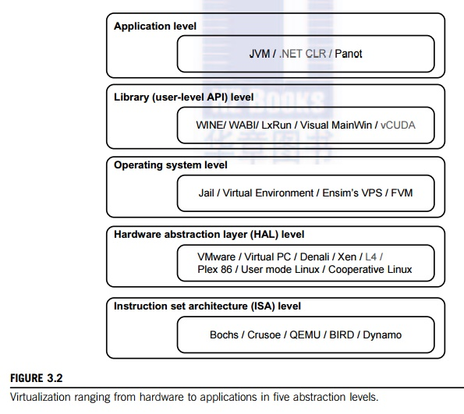
Implementation levels

Slide 13
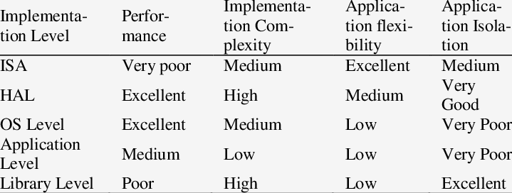
Comparison among levels

Slide 14
Virtualization Providers
Microsoft
VMWare
Oracle

Slide 15
Virtualization structure
Hosted
Bare-Metal

Slide 16
Virtualization structure
Hosted
Bare-Metal

Slide 17
Virtualization Mechanism
Binary Translation
Hardware Assist
Paravirtualization

Slide 18
Open source technology
KVM
Xen

Slide 19
Binary translation with Full Virtualization
Paravirtualization with Compiler support

Slide 20
Data security in cloud
Data stored on cloud
Data availability
Data performance
Price
Flexibility
Data security & Integrity

Slide 21
Challenges with cloud data
Challenges with Data Redundancy
Challenges with Disaster Recovery
Challenges with Data Backup
Challenges with Data Replication
Challenges with Data Location
Challenges with Data Reliability
Challenges with Data Integration
Challenges with Data Transformation
Challenges with Data Migration

Slide 22
Challenges with Data Security
Security Risks
Snooping
Unauthorized Discovery
Spoofing
Accidental deletion
Denial of service attacks
Quality of service
Data Availability

Slide 23
Data Confidentiality & Encryption
Confidentiality: way of protecting data using encryption
Asymmetric Encryption
Symmetric Encryption
Key protection
RSA, DES
Key length

Slide 24
Data Availability
Availability(%) | Downtime per month | Downtime per Year
99 | 7.20hrs | 3.65 days
99.5 | 3.60hrs | 1.83 days
99.9 | 43.2 min | 8.76 hrs
99.99 | 4.32 min | 52.56 min
99.999 | 25.9 sec | 5.26 min
99.9999 | 2.59 sec | 31.5 sec

